Slide 1
The Reporting Pilots
Lucy Reed KC
St John’s Chambers, 36 Group,
The Transparency Project
1 February 2024

Slide 2
4 reasons to grapple with the RP
A reporter may attend your case
Your client may ask you about reporters or telling their story
FLBA members (and pupils) = potential legal bloggers
You might think your case holds wider public or professional interest

Slide 3
Context: Transparency Review report Recommendations Oct 21
Creation of Transparency Implementation Group ✅
Pilot reversal of presumption against reporting of family proceedings to allow journalists and legal bloggers to report on proceedings more easily ✅
Creation of media liaison committee ✅
Anonymisation unit to assist in publication of anonymised judgments ❌🟠
Review and consolidation of existing guidance ❌🟠

Slide 4
Transparency Review report Recommendations Oct 21
Lists to be more informative and accessible to reporters 🟠
Annual review of operation of Family Court ❌
Standard reporting permission order in FR to be subject of brief consultation
Better data collection
President indicates support for review of s12 AJA

Slide 5
Progress at Jan 24
TIG created :Subcommittees: pilot, media, data, anonymisation, FR
Reporting Pilot launched 30 Jan 23 in Cardiff, Leeds & Carlisle (children), Public law first, then private law (May), then magistrates level (Dec)
TP Guidance ‘What to do if a reporter attends (or wants to attend) my hearing? Jan 23
FRC Subcommittee of TIG reported in April. Supported anonymised reporting,
Reporting Pilot extended to 16 more courts from 29 Jan, private law first (judges only)
FR Reporting Pilot launch in CFC, Leeds & B’ham from 29 Ja, HCt @RCJ from Nov 24

Slide 6
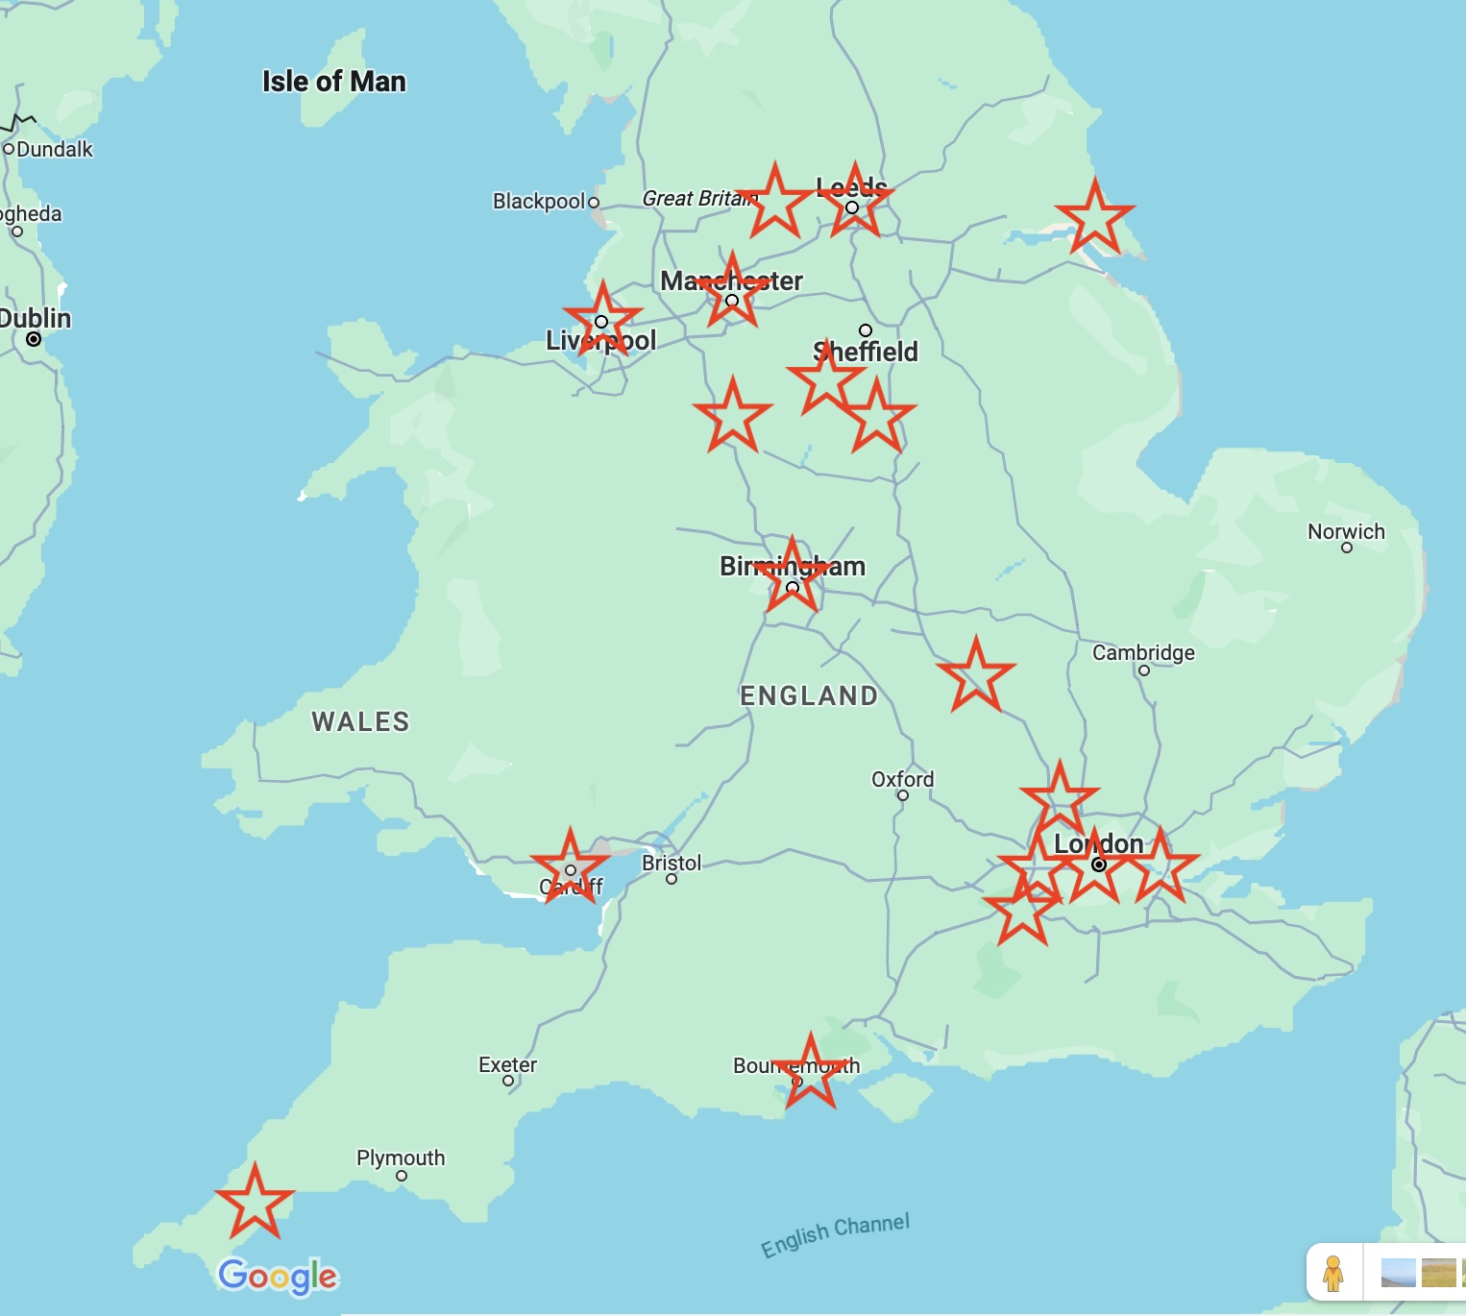
Pilot Coverage 2024
2023 batch: Cardiff, Carlisle, Leeds
2024 expansion batch: Liverpool, Manchester, W Yorks (Leeds, Bradford, Wakefield), Hull (Kingston upon Hull, Grimsby, Beverley), Nottingham, Stoke (Stoke on Trent, Stafford & Newcastle-U-Lyme Mags), Derby (& Chesterfield), Birmingham, Dorset, Truro, Luton, Guildford, Milton Keynes, CFC, E & W London.
2024 FR batch: CFC (incl RCJ overflow), Birmingham, Leeds

Slide 7
Which types of cases?
CHILDREN
All apps for public & private law Orders under Parts II & IV CA1989, including FDAC (with care), caution re reporting of any without notice matter
Apps to discharge, vary or enforce existing Orders,
Placement apps where made within care proceedings (up to making / refusal of PO)
Inherent jurisdiction apps incl DoL.
FR
FR apps on divorce
Apps under Part III of the M&FPA 1984
Schedule 1 CA1989
NOT
ToLATA,
FLA Pt IV
Appeals or matters heard in open court.

Slide 8
Who’s who?
Transparency Implementation Group (TIG) = Pres Fam Div’s mega-committee, chair Lieven J
Transparency Project = educational charity who seeks to make family justice clearer, registered educational charity for purposes of PD27B 4A.1(c) (can send lawyers to hearings as legal bloggers)
Reporting Pilot (aka Transparency Pilot!) implemented by TIG on behalf of Pres Fam Div
Individual members of TP are members of TIG but TP do not run the pilot

Slide 9
Attendance of ‘Reporters’
(Applies to children and FR cases)

Slide 10
FPR 27.11(2) / PD27B
Journalists: (f) duly accredited representatives of news gathering and reporting organisations (since 2009)
Legal bloggers: (ff) a duly authorised lawyer attending for journalistic, research or public legal educational purposes (since 2018)
Duly authorised = practising cert; lawyer with a HE institution; or lawyer working with registered educational charity i.e. TP
Lawyer: QLD, CPE, GDL, SQE, PG legal qualification or CILEX L6 diploma/fast-track diploma

Slide 11
FPR 27.11(2) / PD27B
Right of attendance applies to almost all hearings held in private (not FDR or conciliation type hearings, not adoption/HFEA)
Reporters do not need to ‘apply’ – parties must raise objections w/ref to r27.11 (or court can exclude of own motion)
Reporter has right to make (and hear) representations (before a decision) if objection is raised (r27.11(4))
Exclusion may be for whole or part of hearing (depending on what is necessary and proportionate)
Attendance does not equate to free rein on reporting

Slide 12
27.11(3) – exclusion of reporters
At any stage of the proceedings the court may direct that persons within paragraph (2)(f) and (ff) shall not attend the proceedings or any part of them, where satisﬁed that –
this is necessary –
(i) in the interests of any child concerned in, or connected with, the proceedings;
(ii) for the safety or protection of a party, a witness in the proceedings, or a person connected with such a party or witness; or
(iii) for the orderly conduct of the proceedings; or
(b) justice will otherwise be impeded or prejudiced.

Slide 13
Children Cases
Basic legal framework

Slide 14
S97 Children Act 1989
Protects identity of subject child AS subject child (name, pic, address) to public at large or any section of public (template order is too broad)
Applies only during proceedings (unless extended)
Can be relaxed (s97(4)) where ‘welfare requires’ (which may include where necessary to properly balance Art 10/8 rights)
Criminal offence if breached

Slide 15
S12 Administration of Justice Act 1960
The publication of “information relating to proceedings before any court sitting in private” = contempt in the following cases:
All CA 1989 (incls sch 1) / ACA 2002 / IJ children cases
Any other case wholly or mainly concerned with the maintenance or upbringing of a child
NB This may catch some FR cases and sch 1 cases
But not a contempt if authorised by rules of court (FPR 12.73, 12.75, PD9B, PD12G, PD14E,)
The FPR create many types of permitted disclosure but expressly do not permit ‘communication to the public at large, or any section of the public, of any information relating to the proceedings’ (12.73(1)(b))

Slide 16
What does s12 actually mean?
Read Kent County Council v B, sub nom Re B (A Child) (Disclosure) [2004] EWHC 411 (Fam); [2004] 2 FLR 142 (pa 66)
TLDR : it’s complicated and fuzzy around the edges.
This makes it difficult to safely and responsibly report, and hard to enforce flagrant breach.

Slide 17
Adjusting the default provisions
S12(4) AJA and the FPR empowers court to adjust default provisions:
12.73(1)(b) & (c) authorise the court to permit specified communication of information or adjust the default permissions in r12.75 / PD12G
Where potential publication of information to world at large, use IJ / HRA approach. Incidental / supplemental orders don’t require HCt (K (Children) (Powers of the Family Court) [2024] EWCA Civ 2)
In children cases the pilot operates by the court making a ‘Transparency Order’ under these powers.

Slide 18
Features of the Reporting Pilot
T.O. made when a reporter first attends, usually at start of hearing.
Reporters entitled to see specified documents (and potentially others on application). T.O. regulates publication of contents.
Reporting may be deferred if e.g. criminal proceedings pending.
Reporters permitted to report on what they have seen, heard and read. Interviews of parties permitted. Reporter may quote from interview and docs. All on condition of anonymity for the family as per T.O..
Court is still sitting in private and s12 AJA still applies, save to the extent the T.O. adjusts it. Contempt of court to breach TO. Public not admitted.
A T.O. offers protection and clarity to family (privacy) and reporters (supporting Art 10).

Slide 19
Template T.O.
Anonymity of family members by prohibition of identifying details (names, photos, addresses, hospital, school, treating drs etc)
Docs to be provided: skeletons, chronologies, position statements, index, case outline, threshold. No reporting of quotes from undisclosed source docs without permission.
ID of public bodies, Dir CS, experts, legal reps and judges and anyone named in published judgment permitted but not usually frontline social workers and guardian
Effect of s97 (identification) replicated and bolstered - and extended till youngest child 18 as quid pro quo
Permission applies to reporters and allows parents to speak to reporters, but does not authorise publication by parents
No publication of ‘details’ of sexual abuse allegations without permission.
Permission to report usually effective from end of hearing in question (adjust if required).

Slide 20
To make a TO or not to make a TO?
Pilot said to ‘reverse default presumption ’ embodied in s12 AJA. But it is not automatic.
Template TO may meet the needs of many cases, the template may need to be adjusted to fit.
In some cases it won’t be appropriate to make a TO or reporting may need to await (eg criminal matters).
A ‘Re S’ balancing exercise is still required

Slide 21
Lord Steyn’s four propositions
First, neither article has as such precedence over the other. [Art 8 / 10]
Secondly, where the values under the two articles are in conflict, an intense focus on the comparative importance of the specific rights being claimed in the individual case is necessary.
Thirdly, the justifications for interfering with or restricting each right must be taken into account.
Finally, the proportionality test must be applied to each. For convenience I will call this the ultimate balancing test.
(Re S [2004] UKHL 47, pa 17)

Slide 22
To make a TO or not to make a TO?
In many (most) cases the Re S exercise will be straightforward and need not delay matters more than briefly.
"It is not a mechanical exercise to be decided on the basis of rival generalities. An intense focus on the comparative importance of the specific rights being claimed in the individual cases is necessary before the ultimate balancing test in the terms of proportionality is carried out.” (per Wall J in Re W [2005] EWHC 1564 (Fam))
Welfare is a component of a child’s Article 8 rights. Welfare is ‘A primary consideration’ but NOT paramount (ZH (Tanzania) v SSHD [2011] UKSC 74).
Delaying a decision is an Art 10 interference Griffiths v Tickle & Ors [2021] EWCA Civ 1882.

Slide 23
Financial Remedy cases

Slide 24
General limits on publication in FR (maybe)
Judicial Proceedings (Regulation of Reports) Act 1926?
Implied undertaking not to disclose (see Clibbery v Allan (No 2) [2002] EWCA Civ 45; and Hodgson v Imperial Tobacco Ltd [1998] EWCA Civ 224.
Civil liability for breach of duty of confidentiality?
S12 if wholly or mainly ref child?

Slide 25
The FR Pilot
Similar concept to children pilot -Adapted Transparency Order
Cuts through any controversy about default position by case specific balancing exercise and adoption (in many cases) of some version of a TO
Lists will continue to name parties (High Court to come back into line w/ rest of country)
BUT pilot permits only anonymised reporting
Does not impinge on FDRs/ confidentiality of settlements
Access to docs ES1 (not ES2) and interviews permitted subject to TO

Slide 26
The FR T.O.
As with Children T.O., facilitates and regulates reporting providing clarity and protection for parties and reporters
Protects:
Names and addresses of school, place of work, real property,
identity of accounts, investments, employer, private company or partnership,
identity of non-expert witnesses.

Slide 27
What to do if a reporter attends (or wants to attend) your hearing?
TP Guidance based on case law and hands on experience of use of FPR 27.11.
Key principles
Reporters do not need to apply to attend (most) hearings
What a reporter is permitted to report will depend on the nature of the hearing / proceedings
A reporter should not be asked to reveal their source
Editorial control of reporting not part of court’s function
Communication is key
Due process - involve reporters in decision making
NB Refer to RP and non-RP versions Jan 24

Slide 28
Some practicalities (both pilots)
LCJ Guidance, June 22 ‘Open Justice – Remote Observation of Hearings – New Powers: ‘Remote observation should be allowed if and to the extent it is in the interests of justice; it should not be allowed to jeopardise the administration of justice in the case before the court’, (NB including remote attendance by a reporter of an otherwise fully attended hearing)
Docs don’t need redaction before being given to reporters – T.O. prohibits publication of identifying elements.
Pilots encourage notice from reporters. Not always possible due to listing.
Duty and expectation of mutual co-operation by lawyers and reporters. Learning curve for everyone – ask questions, pool experience and ideas.

Slide 29
Help grow legal blogging
Good CPD for established practitioners and good experience for pupils and junior tenants. TP can support and host.
Please let us know about interesting cases (human, public or legal interest or where legal explanation may complement / rebalance MSM coverage). (subject to duties to client). We do not reveal sources.
If you refer clients to TP, PLEASE ask them to read FAQs so they send the information we need and do not send information they are not allowed to!
Email trustees@transparencyproject.org.uk

Slide 30
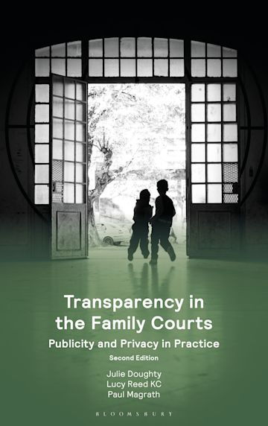
Resources
TP: www.transparencyproject.org.uk
Guidance - What to do if a reporter attends (or wants to attend) your hearing https://transparencyproject.org.uk/resources/ (updated Jan 24)
Legal bloggers information www.transparencyproject.org.uk/legalbloggers
TIG and RP information links: https://linktr.ee/TransparencyImplementation
FR TIG Subgroup report https://www.judiciary.uk/guidance-and-resources/final-report-of-the-financial-remedies-court-frc-sub-group-of-the-transparency-implementation-group/
FR guidance : https://www.judiciary.uk/wp-content/uploads/2023/12/Reporting.PilotScheme.Final_.President.pdf
TBIJ: www.thebureauinvestigates.com/hubs/family-justice

